Slide 1
Computer Engineering
Generated for: Introduction to Operating Systems, Process Management, Memory Management
Notes:
Welcome to the Computer Engineering presentation covering multiple topics. Today we'll explore: Introduction to Operating Systems, Process Management, Memory Management.

Slide 2
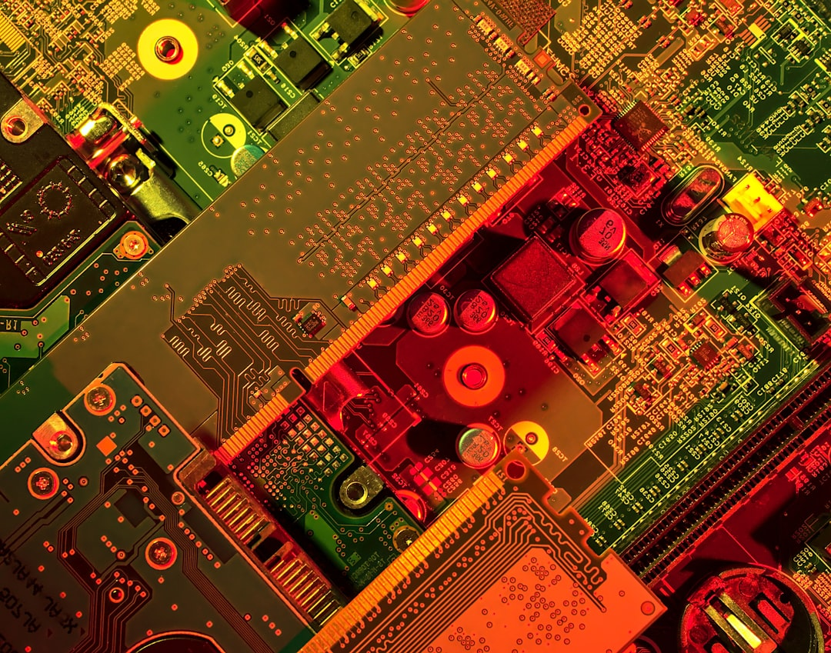
Introduction to Operating Systems: Fundamentals and Overview
Manages computer hardware and software resources efficiently always
Acts as intermediary between user and computer hardware components
Provides platform for running applications and services smoothly
Controls input output and storage devices effectively always
Manages memory and storage for optimal performance always
Provides security and authentication mechanisms for protection
Supports multitasking and multithreading for efficiency
Handles interrupts and exceptions for smooth operation
Enables communication between hardware and software components
Notes:
Welcome to the introduction of operating systems, which plays a crucial role in managing computer hardware and software resources. In this section, we will explore the fundamentals of operating systems, including their functions, types, and characteristics. We will also discuss the importance of operating systems in modern computing and their applications in various fields.

Slide 3

Introduction to Operating Systems: Fundamentals and Basics
Manages computer hardware and software resources efficiently always
Acts as intermediary between user and computer hardware components
Provides platform for running applications and services smoothly
Handles memory management and allocation tasks effectively
Enables input output operations and device management functions
Supports networking and communication protocols implementation
Ensures security and access control mechanisms are implemented
Provides utility programs for maintenance and troubleshooting purposes
Allows multitasking and multithreading capabilities always
Notes:
In this section, we will introduce the basics of operating systems, including their role, functions, and characteristics. Operating systems act as a bridge between the user and the computer hardware, managing resources and providing a platform for running applications. We will explore the key components and features of operating systems, setting the stage for further study and exploration.

Slide 4

Part 3: Introduction to Operating Systems Fundamentals
Manages computer hardware and software resources efficiently always
Provides platform for running applications and services smoothly
Acts as intermediary between user and computer hardware components
Handles memory management and allocation tasks automatically
Supports multitasking and multithreading capabilities fully
Ensures security and authentication mechanisms are in place
Manages file systems and storage devices effectively always
Provides input output operations and interrupt handling
Optimizes system performance and responsiveness always
Allows for networking and communication capabilities
Notes:
In this section, we will introduce the basic concepts of operating systems, including their primary functions and characteristics. We will explore how operating systems manage computer hardware and software resources, and provide a platform for running applications and services. The key points to focus on include memory management, security, and file systems.

